Slide 2
Presentation Overview
Federal Aid Philosophy
Free Application for Federal Student Aid (FAFSA) Process
Types of Financial Aid
How to Determine College Cost
Timeline
Upcoming Events

Slide 3
Federal Aid Philosophy
Financial aid is available to all families regardless of family income or college costs
It is the primary responsibility of the family to pay the educational costs to the extent they are able

Slide 4
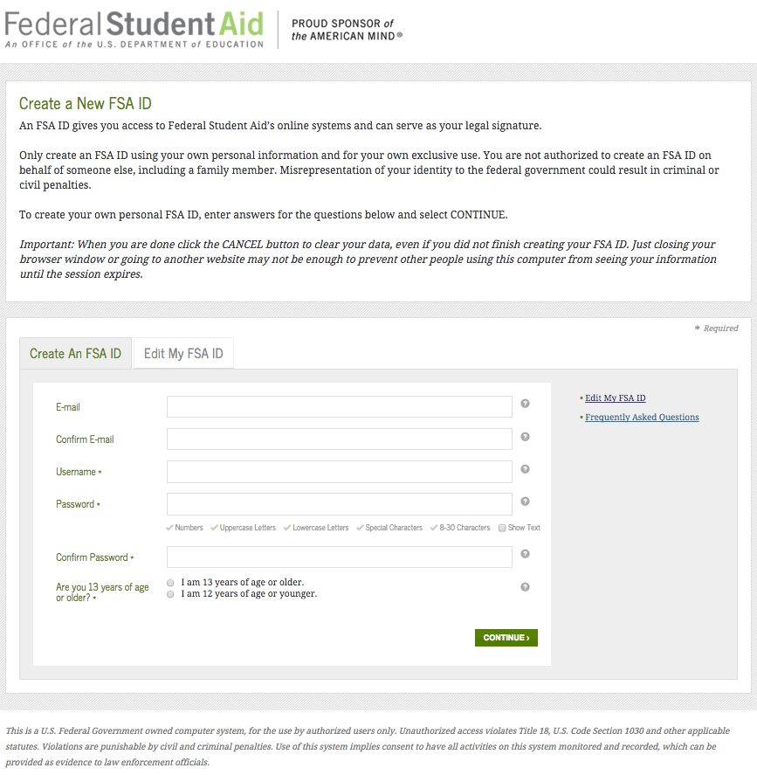
FAFSA Process
FSAID.ed.gov

Slide 5
FAFSA Process
FSA ID Tips
Parent and student must each apply
Separate email addresses for parent and student
Enter existing FAFSA PIN in Step 3
Parents with current college students or who are students themselves

Slide 6
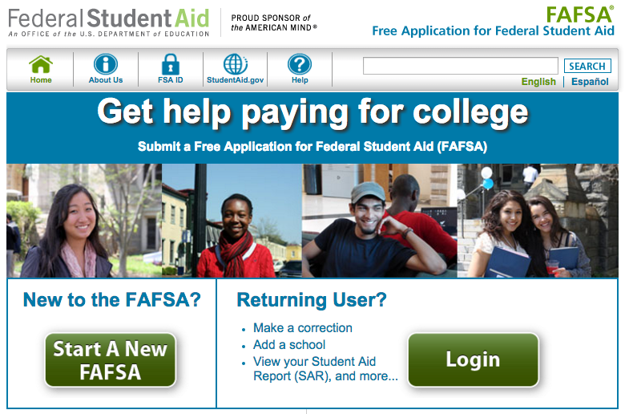
FAFSA Process
FAFSA.gov

Slide 7
FAFSA Process
Avoid Errors
Social Security Number and date of birth mismatch
Divorce or remarried parent
Divorced parent, not remarried = list one parent
Divorced parent, remarried = list parent and step-parent
List parent on FAFSA (and spouse if remarried) who pays 51% of student’s expenses (housing, food, clothing, school expenses, etc.)
Parent and student income mismatch
Report income and taxes paid in appropriate fields

Slide 8
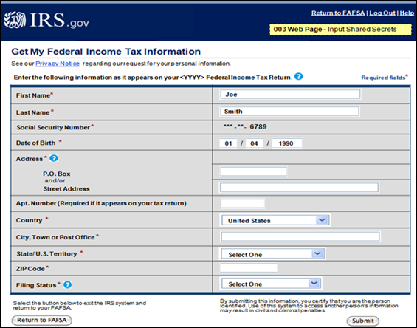
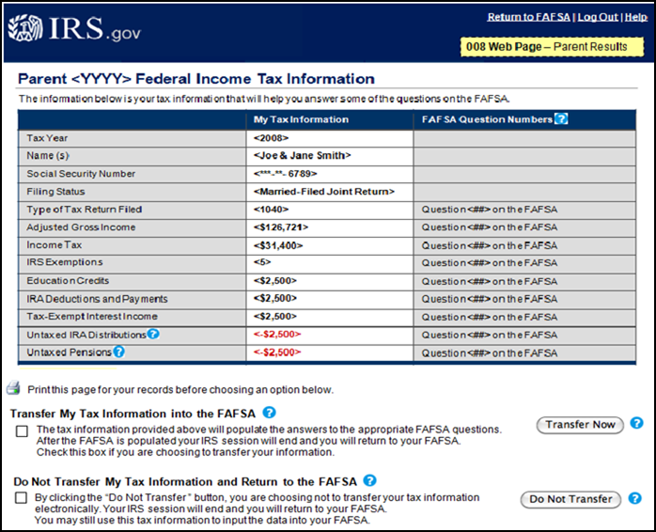
FAFSA Process
Use IRS Data Retrieval Tool - Reduce Errors
Available two weeks after electronic tax filing

Slide 9
FAFSA Process
Assets
Cash, savings and checking
Real estate
Personal investments
Mutual funds, CDs, money markets, stocks and bonds
UTMA and UGMA (trust account)
College savings plan (529)
List as asset for parent, not student

Slide 10
FAFSA Process
Not Assets
Retirement accounts
401K, 403B, IRA (non-education)
Home where you live
Life insurance policies
Small family business
If 100 or fewer full-time employees
Family farm
As long as family resides on property

Slide 11
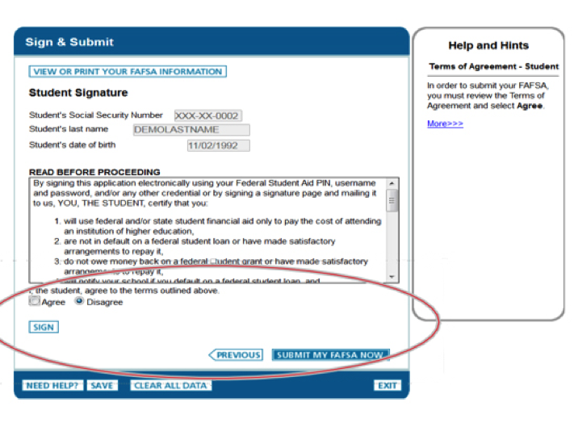
FAFSA Process
Student click
Parent enter FSA ID and click
Then submit
SIGN
SIGN

Slide 12
FAFSA Process
Print Confirmation Page

Slide 13
FAFSA Process
2017-18 FAFSA is based on the 2015 financial situation
Notify the Financial Aid Office of the following changes:
Unemployment
Separation, divorce or death of spouse
Loss of untaxed income (child support)
Parent in college
Excessive medical or dental expenses
Paying private tuition for K-12 education

Slide 14
Types of Financial Aid
Gift Aid
Grants
Pell grant amount is listed on FAFSA confirmation page
TEACH grant has stipulations
Scholarships
Self Help Aid
Work Study
Does not impact bill
Loans

Slide 15
Gift Aid
Scholarships
Apply for admission early
Talk with guidance counselors, teachers and relatives
Parent’s employers
Be aware of deadlines
January - February
Online resources
scholarships.com
fastweb.com
yconic.com

Slide 16
Self Help Aid
Federal Direct Stafford Loans
*3.76 fixed interest rate
Freshman loan amount $5,500
Subsidized loan
Interest free while student is enrolled; requires low EFC
Unsubsidized loan
Interest is charged to the loan while student is enrolled
Student may pay the interest every six months
Payment is not required on either while enrolled at least half-time
Repayment typically begins six months after graduation or when enrollment falls below half-time
* 2016-17 rate

Slide 17
Self Help Aid
Federal Parent PLUS Loan
Debt obligation of the parent
*6.31% fixed interest rate
Requires credit approval
Amount varies as parent decides what to accept
If parent is denied, student can request an additional $4,000 federal unsubsidized loan
* 2016-17 rate

Slide 18
Self Help Aid
Private Alternative Student Loans
Bank or credit union
May require a co-signer
Interest rates may be fixed or variable
Canton Student Loan Foundation
Available to graduates of Stark County

Slide 19
Determine College Cost
Cost of Attendance (COA) includes both direct and indirect costs
Direct costs: Tuition, fees, room, board
Indirect costs: Books, computer, transportation
COA: Maximum amount of aid that a student may receive

Slide 20
Determine College Cost
COST OF ATTENDANCE AT KENT STATE STARK
Tuition and fees | 5,664
Room and board (parent’s home, rent) | 3,360
Books, supplies and equipment | 1,290
Transportation | 2,468
Miscellaneous and personal | 1,750
Loan fees | 118
Cost of Attendance Per Year | $14,650
Kent Campus $25,650
Wittenberg University $50,362

Slide 21
Determine College Cost
Net Price Calculator form provided on resource table
Cost minus Aid = Your out-of-pocket cost
Freshmen loan amount is $5,500

Slide 22
Timeline
Now - December
Complete FAFSA
Apply for admission, scholarships and visit campus
January - March
Review aid package and visit campus
April
Decide on a college and attend orientation/registration programs
July - August
Determine out-of-pocket costs
Make arrangements to pay tuition, fees, room and board

Slide 23
Upcoming Events
Campus Preview Saturday, Nov. 5, 2016 9 a.m. - 12:30 p.m. Kent State University at Stark www.kent.edu/stark/campus-preview
In-Person FAFSA Filing Workshop Saturday, Nov. 19, 2016 9 a.m. - 12 p.m. Kent State University at Stark Call to RSVP: 330-244-3257

Slide 24
Contact Us
Student Financial Aid Office Kent State University at Stark 330-244-3251 www.kent.edu/stark/financial-aid
Walk-In Hours Monday - Thursday: 8:30 a.m. - 6:30 p.m. Friday: 8:30 a.m. - 4:30 p.m.

